Slide 1
Properties of Stars & Star Formation
Physics 090
Saint Mary’s College of California
Professor Aaron Lee

Slide 2
Don’t copy down slide text with the little Saturn image – they will be sent to you.
Listen, ask questions, take notes on things I say that seem interesting.
Slide text gives the main ideas.

Slide 3
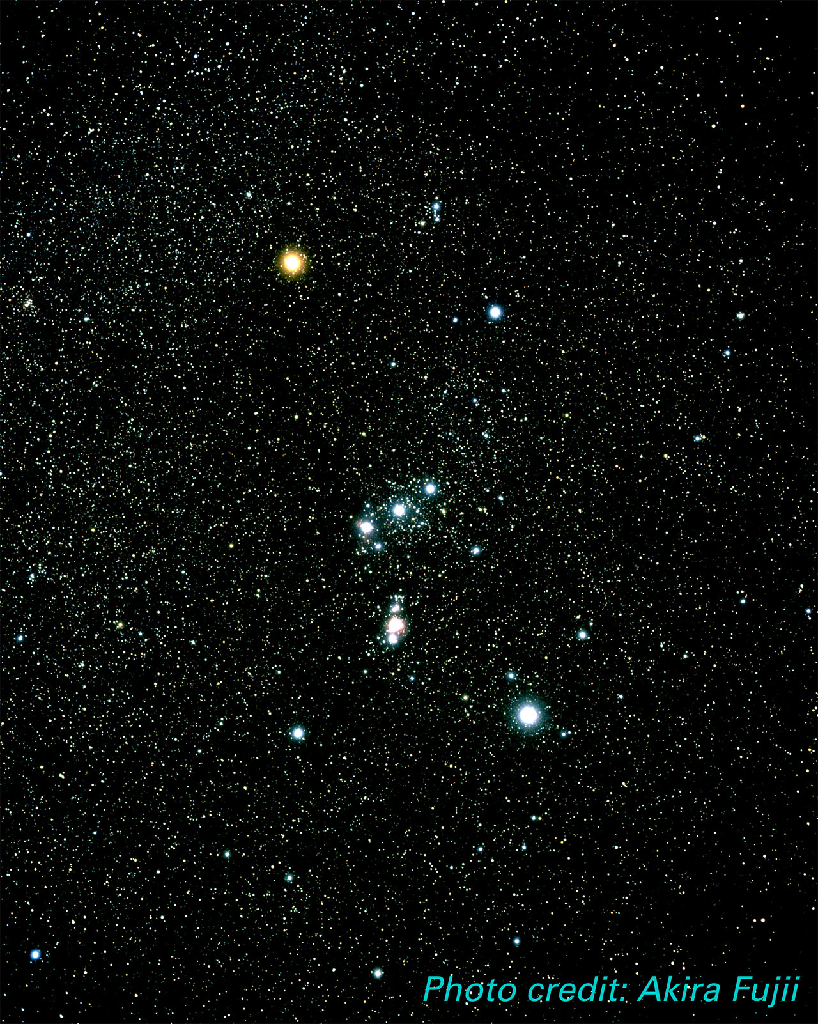
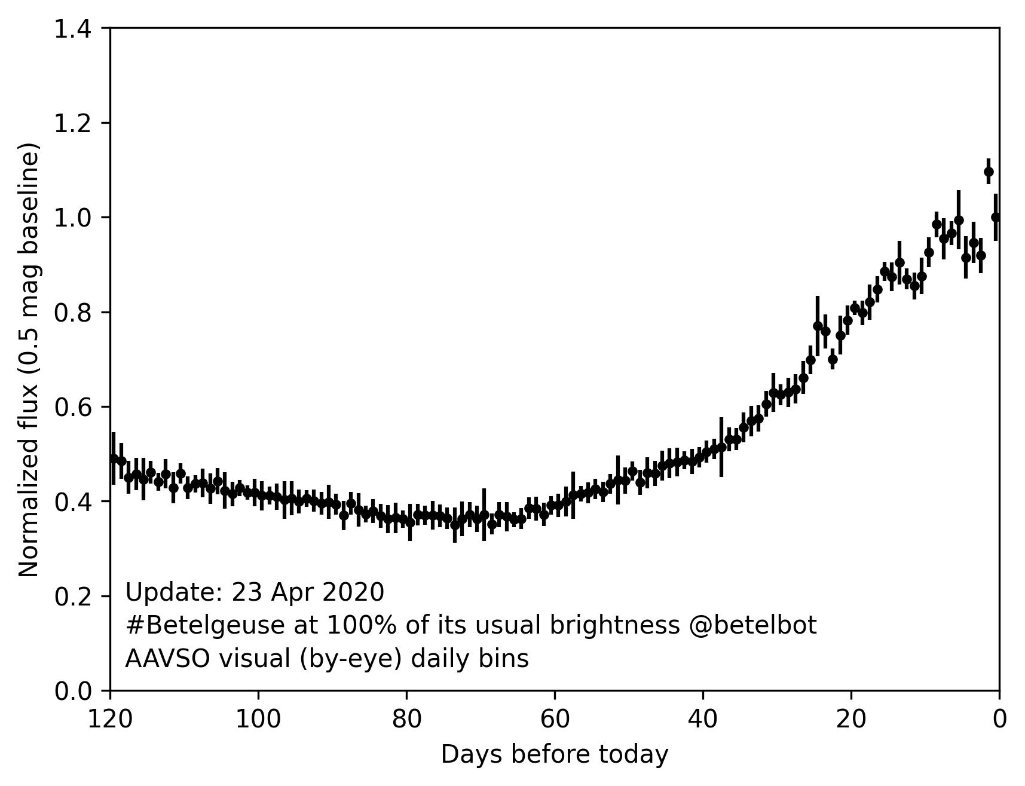
Betelgeuse is OK
Average Brightness
Notes:
Betelgeuse is OK
Could ask how do you know the plot won’t keep going up? Slope.
You’re getting into the part of the course where you’re learning about stars…

Slide 4
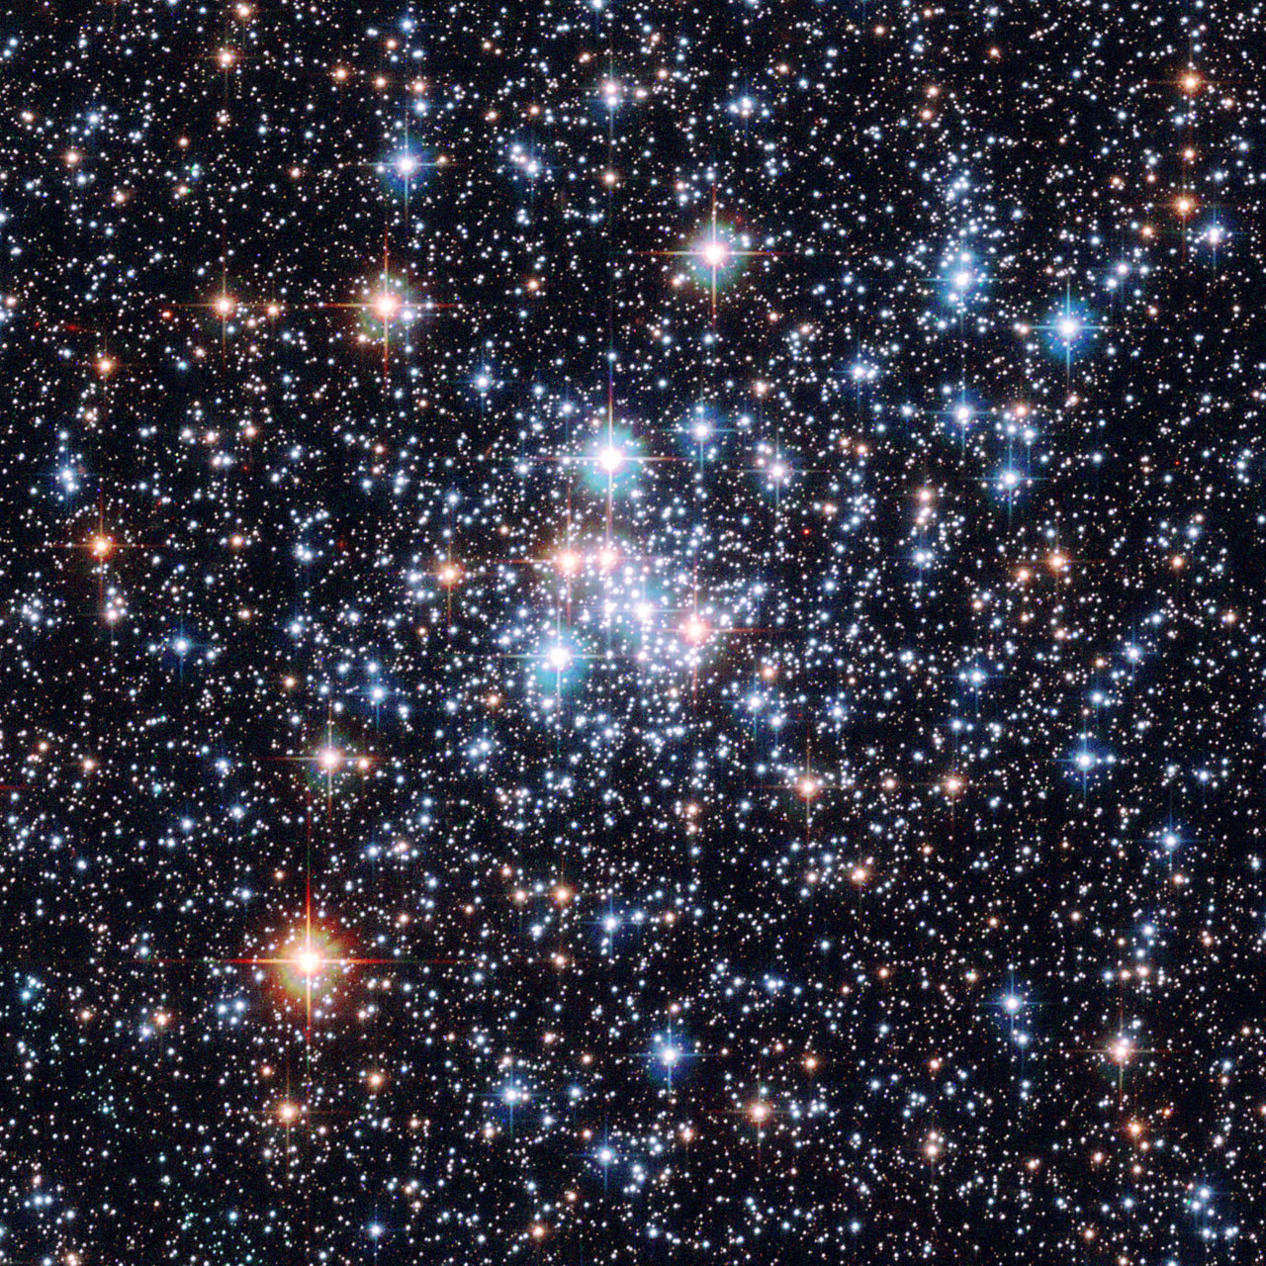
Notes:
Here are some stars if you’ve never seen one before. Some bright, some dim, some red, some blue. Some close, some far, some massive, some small. How do we know?

Slide 5
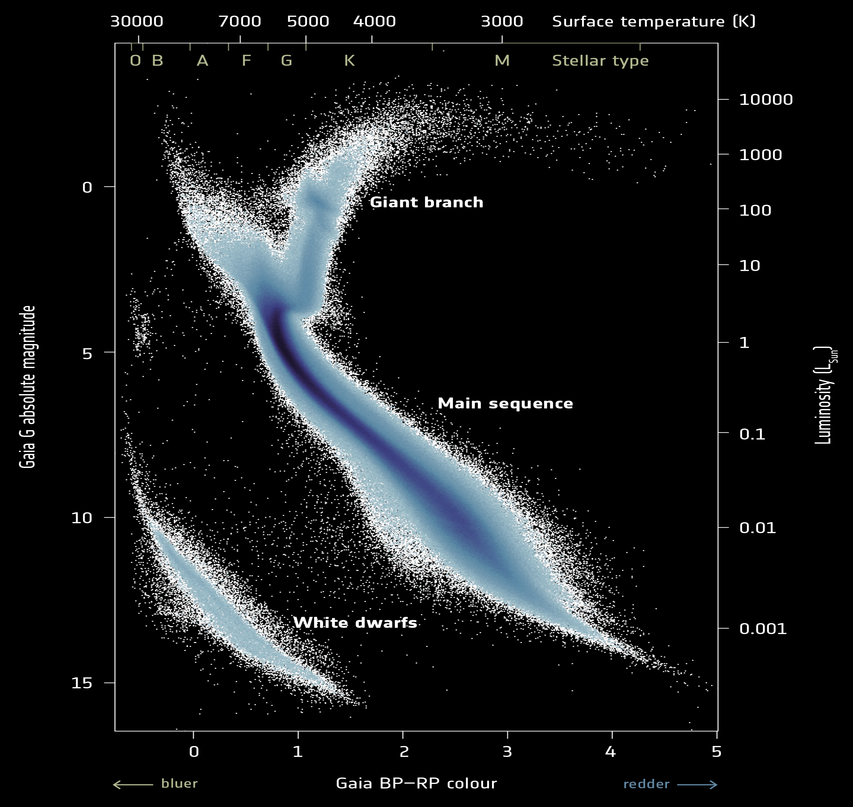
Gaia Data2
← Surface Temp
Magnitude
Luminosity
Notes:
Not all combinations of L and T are possible, and this is also saying something about the evolution of stars based on the density of objects in different regions. The fact most on MS means stars spend most of their time there. Photograph once a day…
Suggests physics at play.

Slide 6
Measuring Properties of Stars
Distance
Parallax method for nearby stars
Brightness (Intensity)
Easy to measure – is it bright or dim?
Luminosity
Get from brightness and distance
Physical relationships for special objects (e.g., Cepheid Variables)

Slide 7
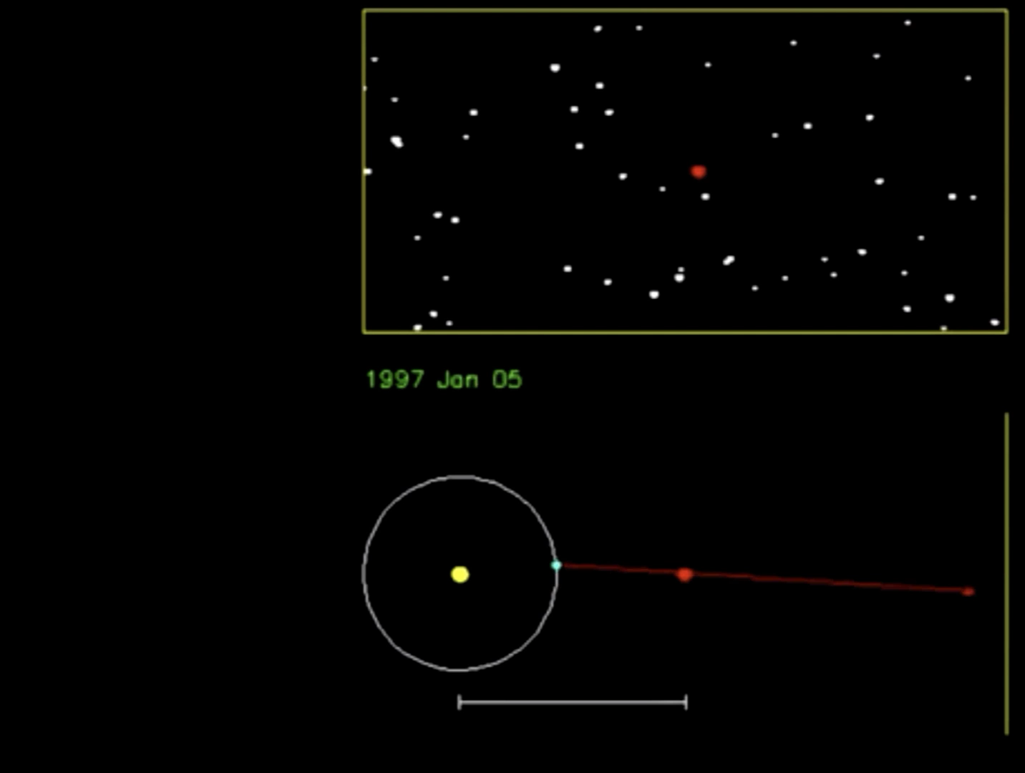

Slide 8
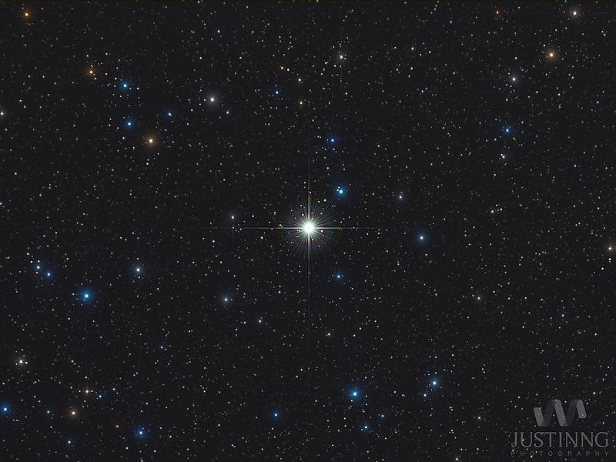
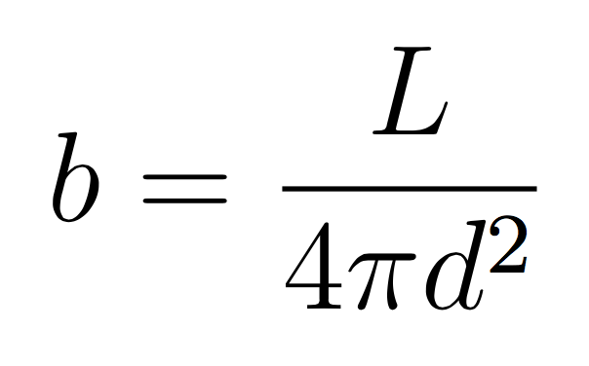

Slide 9

1000 Watts

Slide 10
250 Watts
2x farther away
1000 Watts

Slide 11
10 Watts
250 Watts
10x farther away
1000 Watts
Notes:
Using parallax and brightness gives you L.

Slide 12
Measuring Properties of Stars
Distance
Parallax method for nearby stars
Brightness (Intensity)
Easy to measure – is it bright or dim?
Luminosity
Get from brightness and distance
Physical relationships for special objects (e.g., Cepheid Variables)
Notes:
L is something intrinsic to the object itself!
Sometimes you can get L other ways.

Slide 13
Measuring Properties of Stars
Composition and Surface Temperature
Spectrum shape
Radius
Get from L and T, Stefan-Boltzmann Law
Masses
Binary stars
Physical relationships for typical (“main-sequence”) stars.

Slide 14
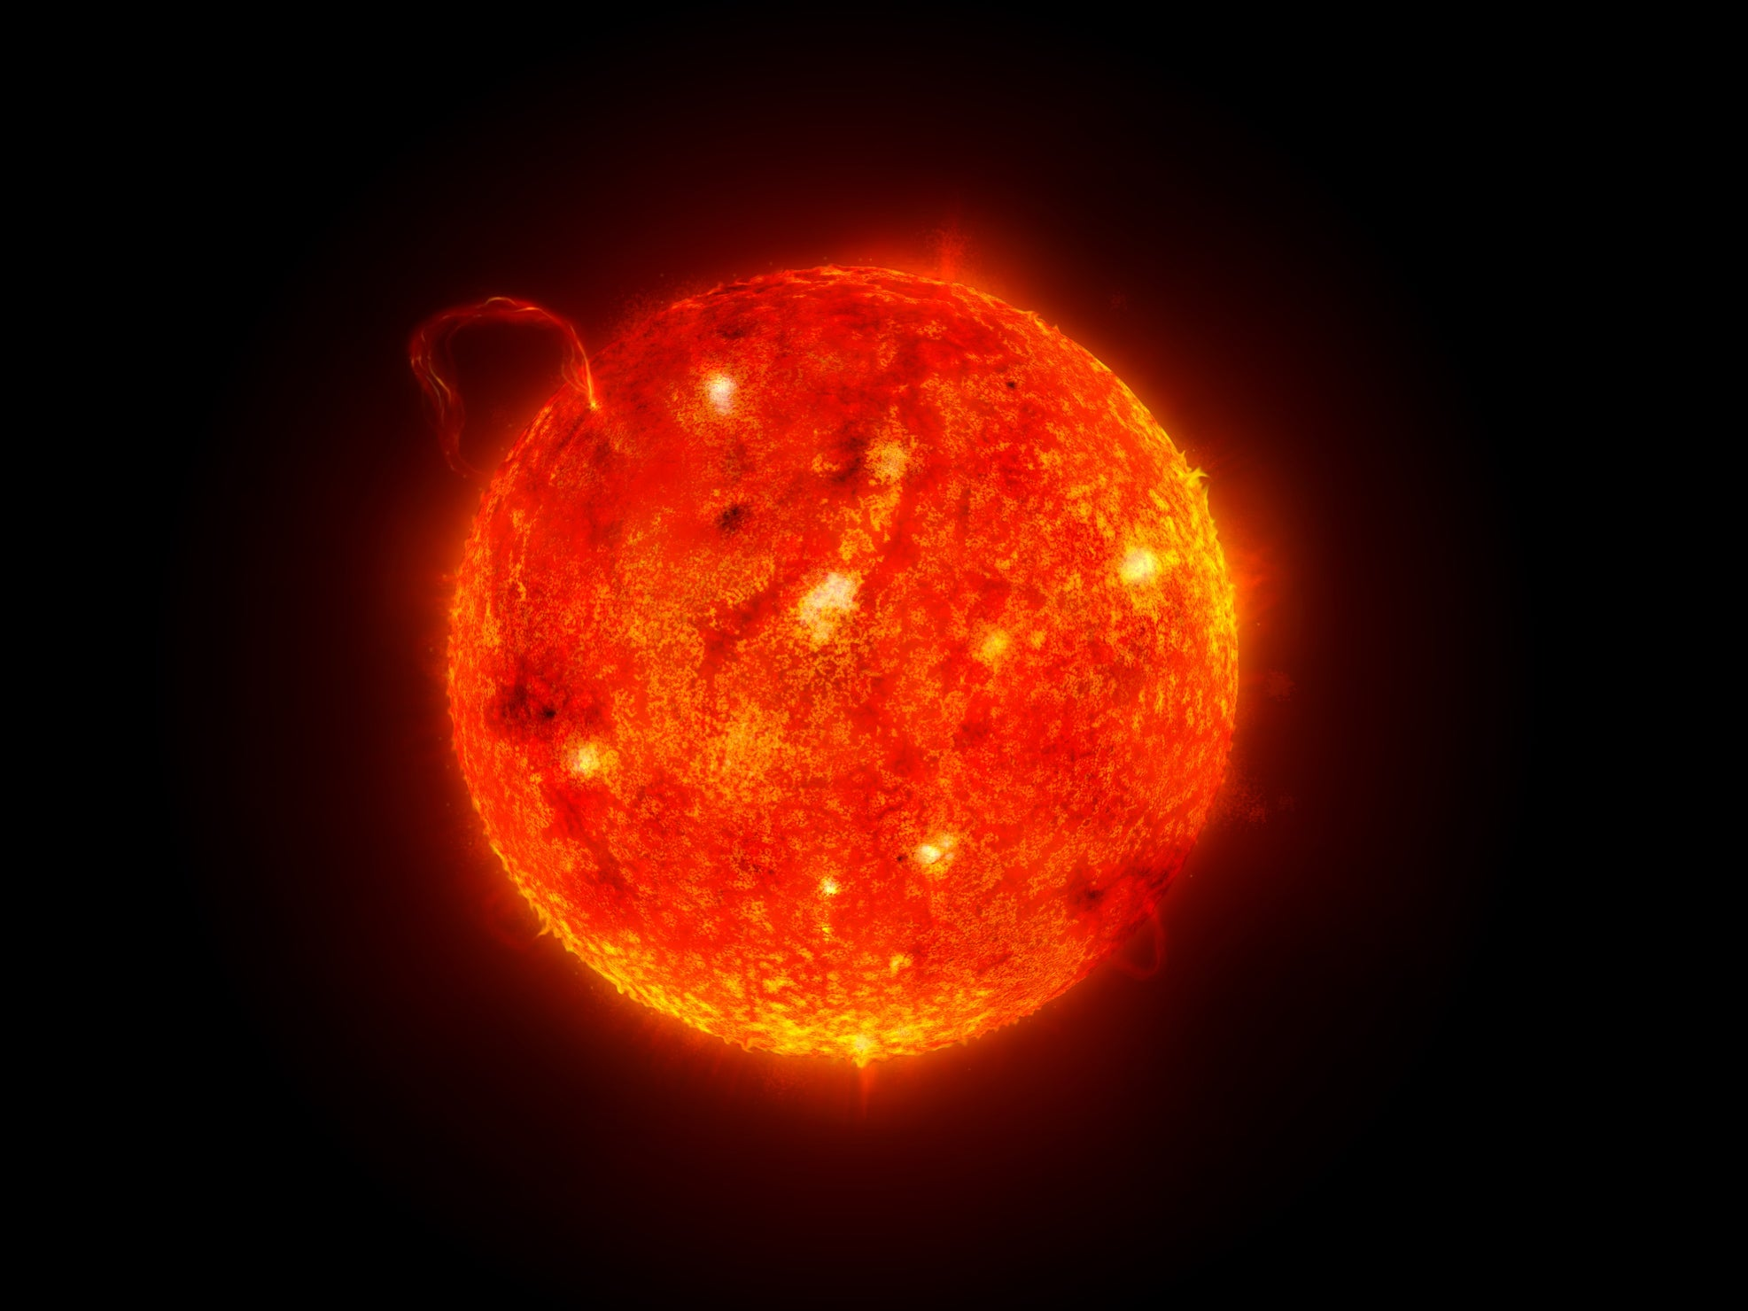
Notes:
Composition and temperature, take the Sun and put its total light through a fancy prism (spectrograph).

Slide 15
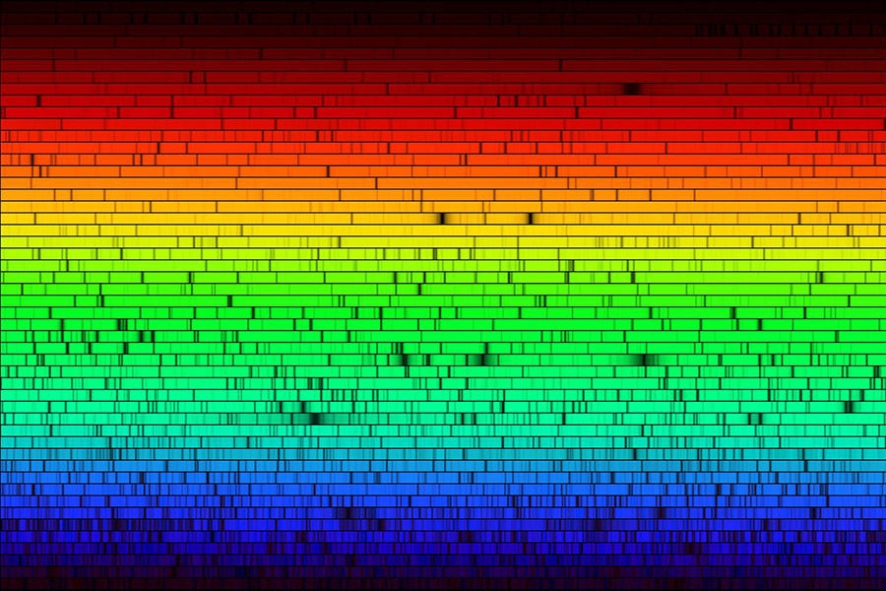
Notes:
Spectrum of the sun (in visible). Brightness gives intensity at each color, also dark patches. (Fraunhofer lines)
Finger prints of atoms and molecules. Each has a unique fingerprint.

Slide 16
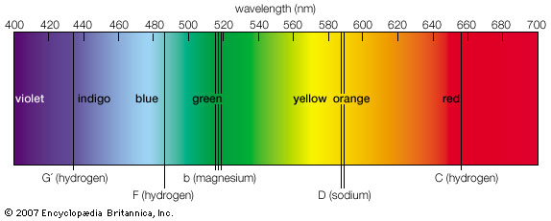

Slide 17
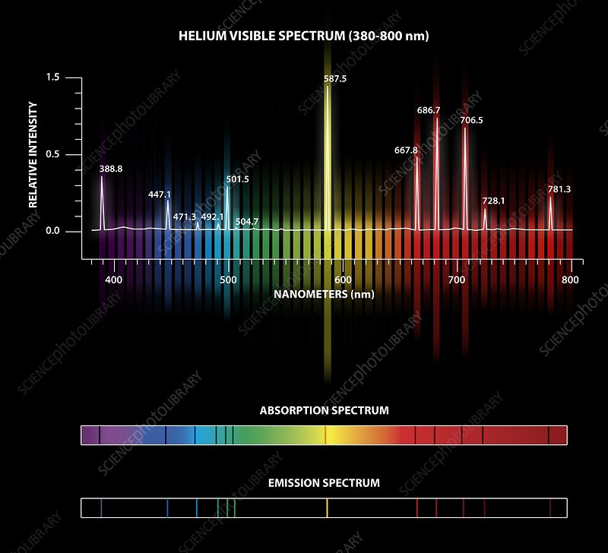

Slide 18
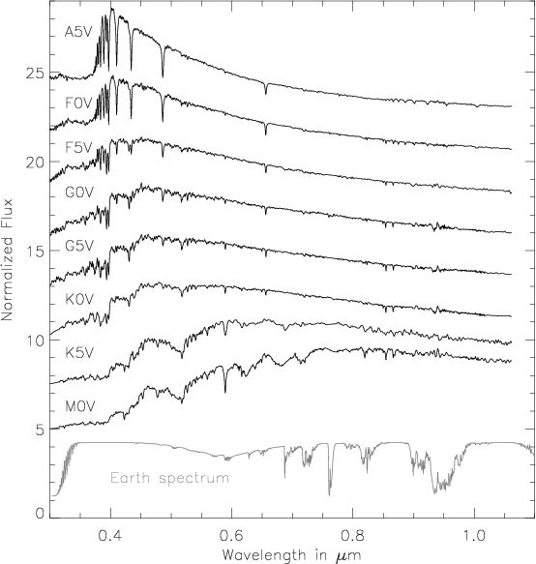
Big
Star
Brightness at certain wavelengths (colors)
Increasing surface temperature →
Sun
Small star
Notes:
Less pretty version of star spectra. Showing where colors are, IR and UV on ends.
Shape and wiggles give temperature and composition.
Wein’s law back in unit 1.

Slide 19
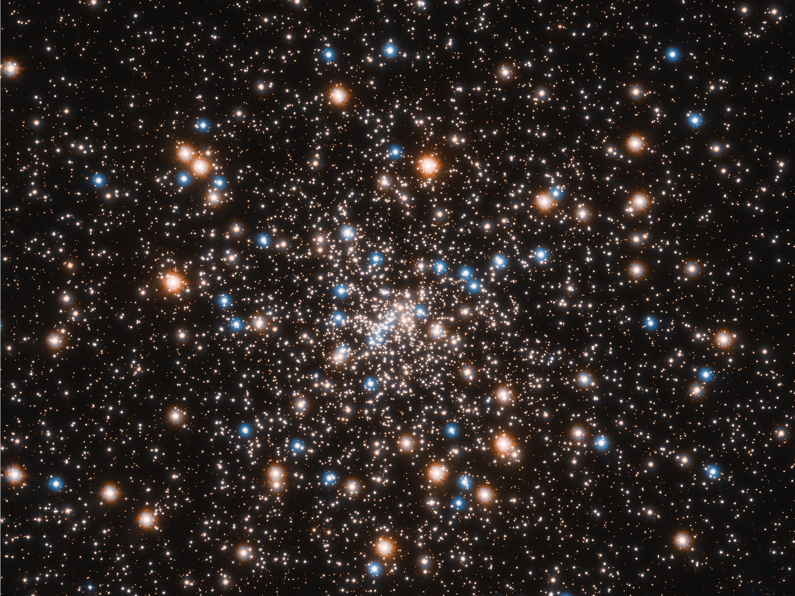
Notes:
Trends starting to emerge with the stars we observe.

Slide 20
Analysis of stellar spectrum
Color, absorption lines, detailed shape gives you temperature and chemical composition
Spectral Class: Primarily based on temperature.
 | Type | Surface Temp (K)
“blue” | O | > 30,000
 | B | 10,000 – 30,000
 | A | 7,500 – 10,000
“white” | F | 6,000 – 7,500
 | G | 5,000 – 6,000
 | K | 3,500 – 5,000
“red” | M | 2,200 – 3,500
 | L | 1,300 – 2,200
“brown dwarfs” | T | < 1,300 (recent)
The Sun: | G2 | T = 5,800 K
Subtypes :
G0 (hottest) to G9 (coldest)

Slide 21
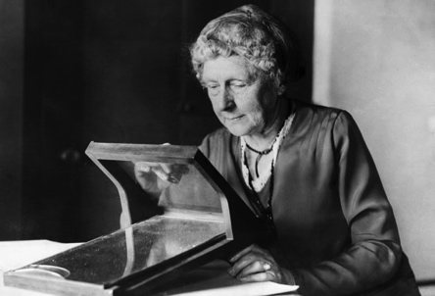
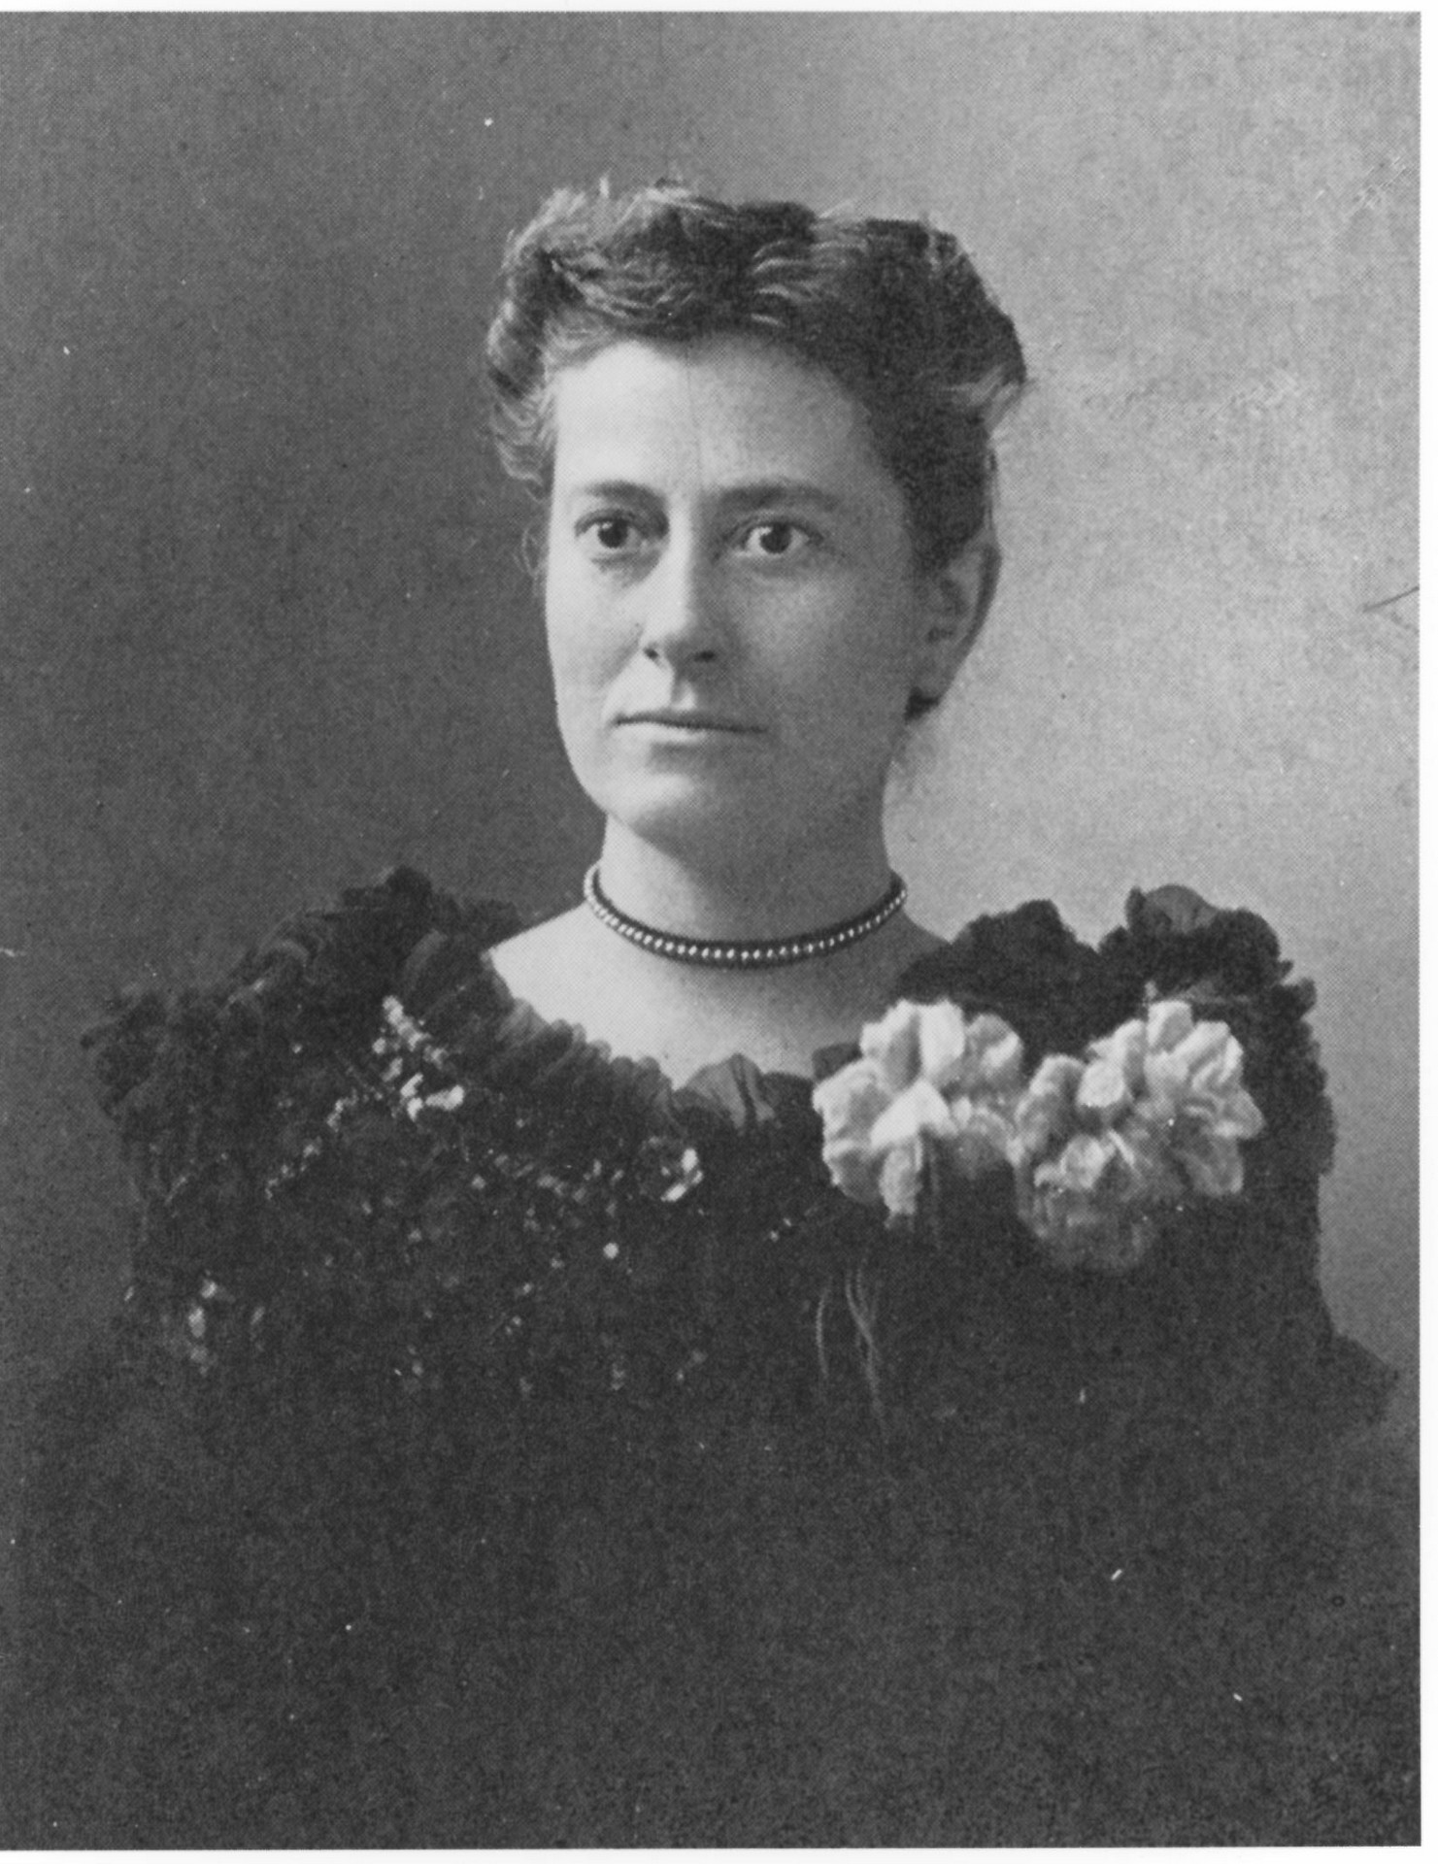
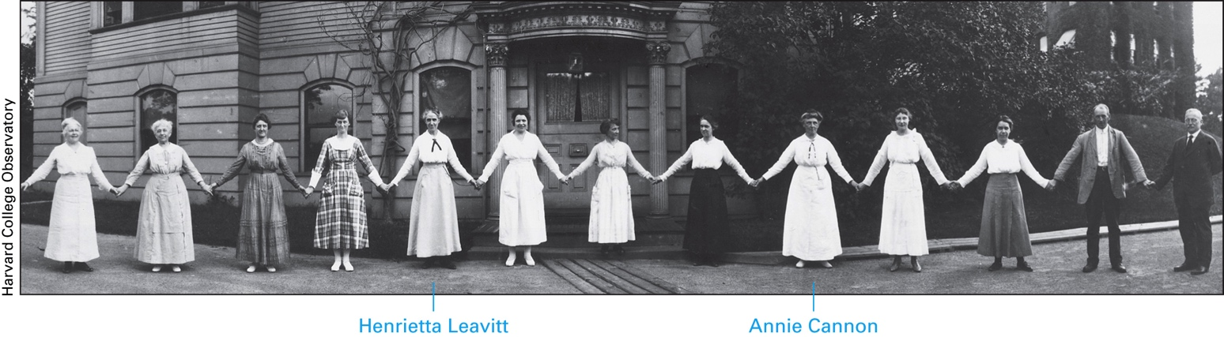
Williamina Fleming (1857 – 1911) Annie Cannon (1863 – 1941)
wf
ac
Notes:
The original scheme was a mess and it was Annie Cannon that made the realization that a much simpler scheme based on temperature could be be made.

Slide 22
Analysis of stellar spectrum
Color, absorption lines, detailed shape gives you temperature and chemical composition
Spectral Class: Primarily based on temperature.
 | Type | Surface Temp (K)
“blue” | O | > 30,000
 | B | 10,000 – 30,000
 | A | 7,500 – 10,000
“white” | F | 6,000 – 7,500
 | G | 5,000 – 6,000
 | K | 3,500 – 5,000
“red” | M | 2,200 – 3,500
 | L | 1,300 – 2,200
“brown dwarfs” | T | < 1,300 (recent)
The Sun: | G2 | T = 5,800 K
Subtypes :
G0 (hottest) to G9 (coldest)
Notes:
Her scheme arranged in descending order of temperature. Don’t memorize the numbers, but memorize the order and understand the trends.
L = recent. Subcategories also have been added.
Various Mnemonics: Only Boring Astronomers Find Gratification Knowing Mnemonics Like These

Slide 23
Measuring Properties of Stars
Composition and Surface Temperature
Spectrum shape
Radius
Get from L and T, Stefan-Boltzmann Law
Masses
Binary stars
Physical relationships for typical (“main-sequence”) stars.

Slide 24
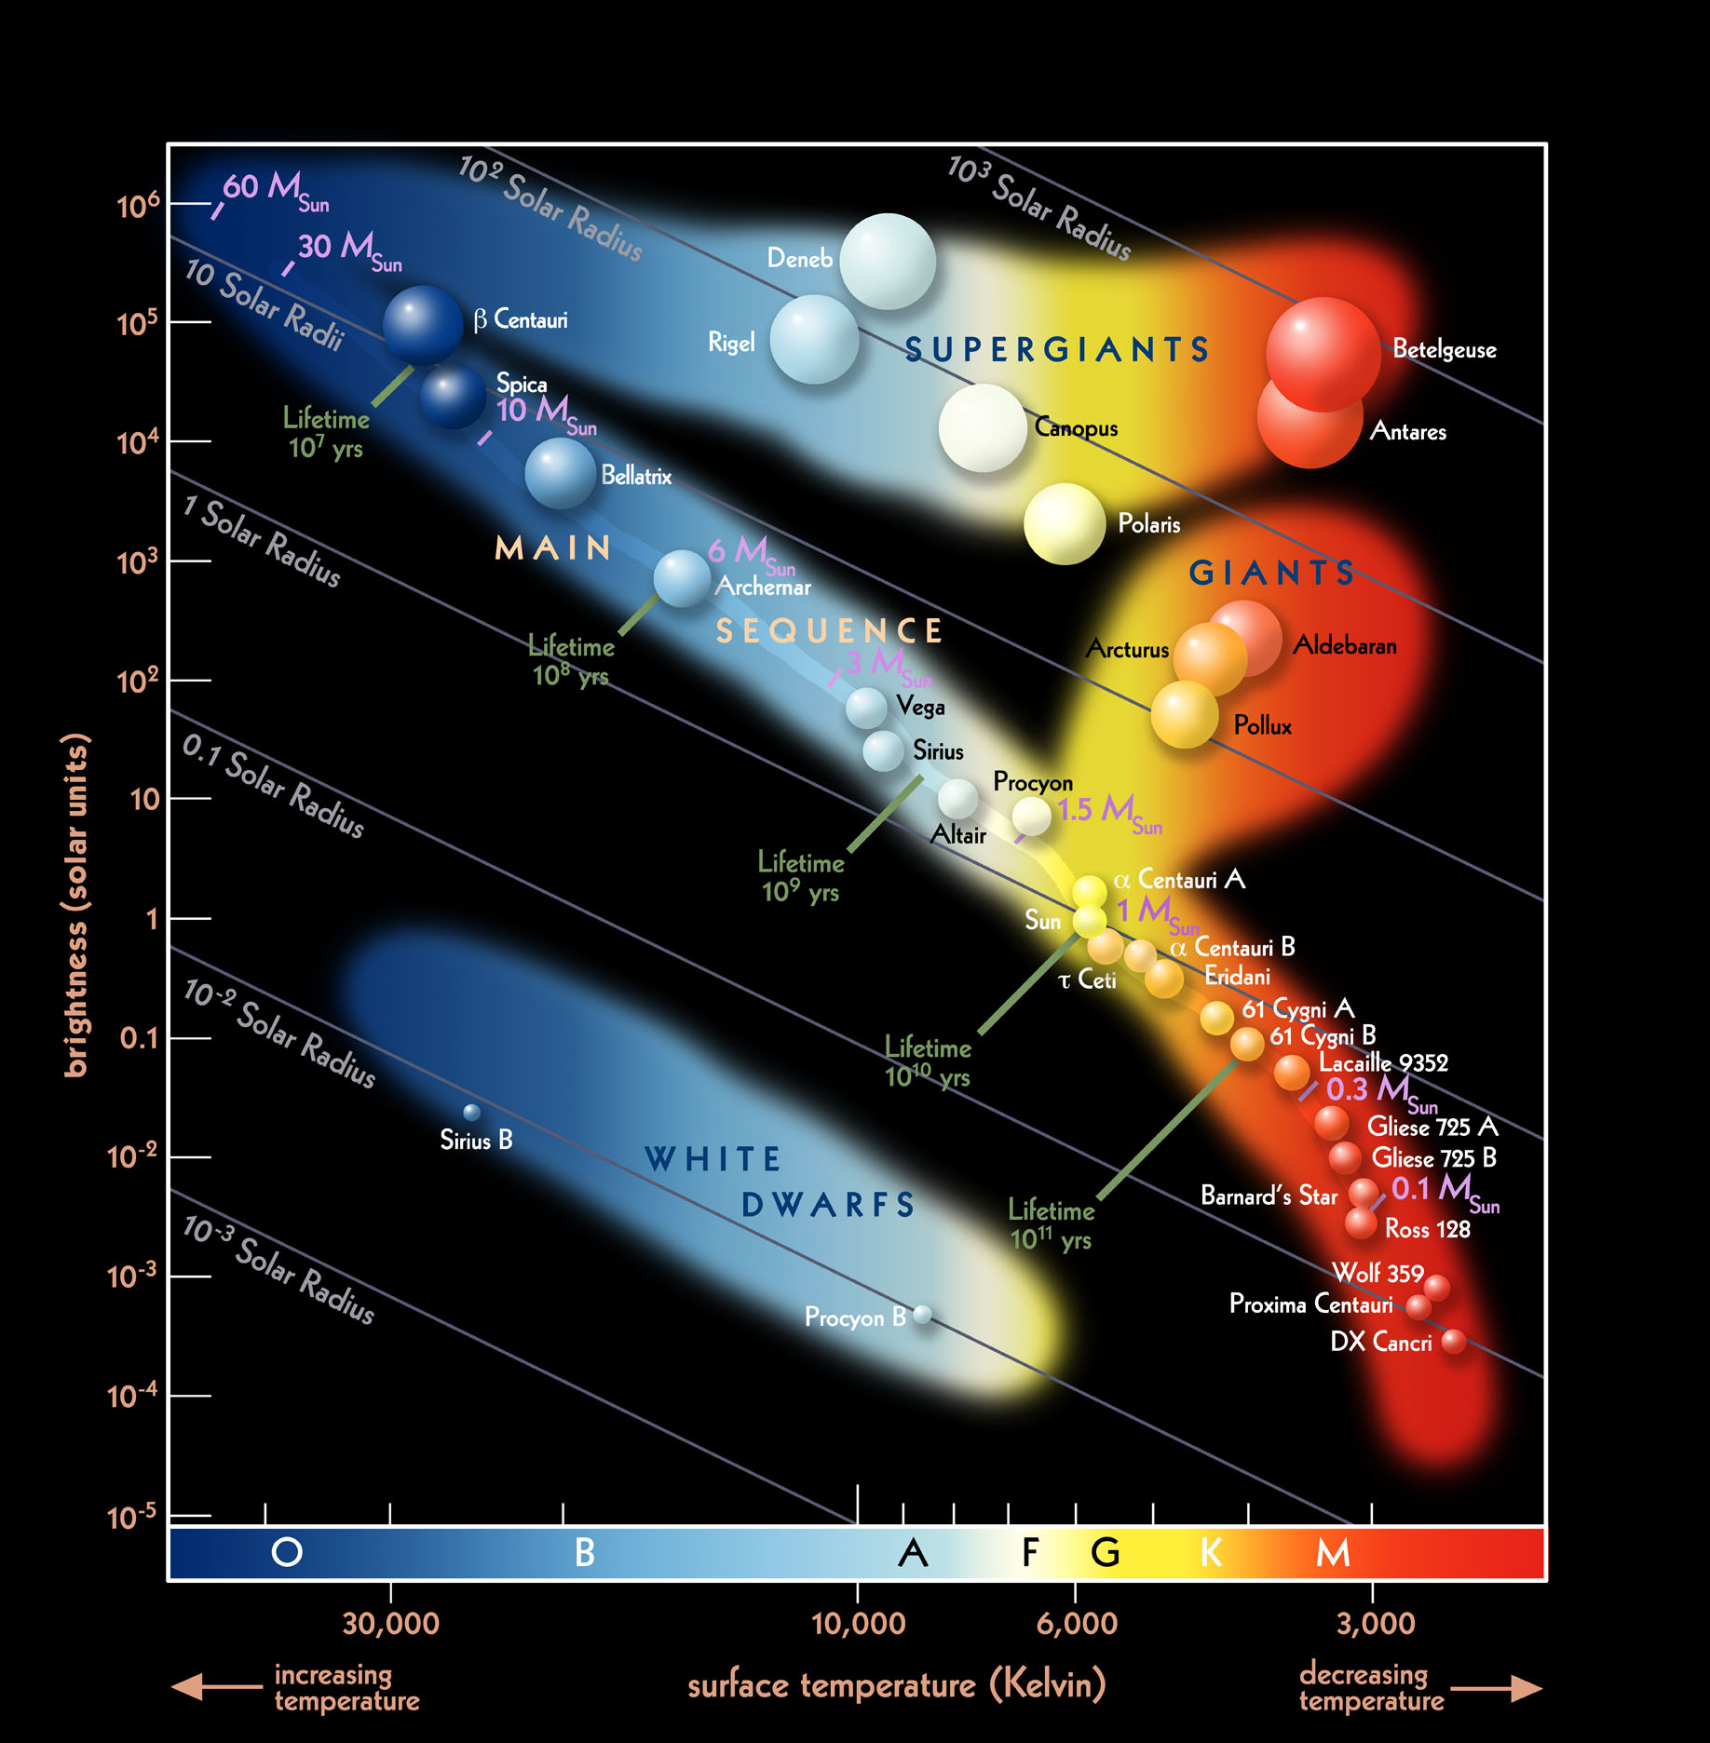
Notes:
Some other relationships exist too

Slide 25
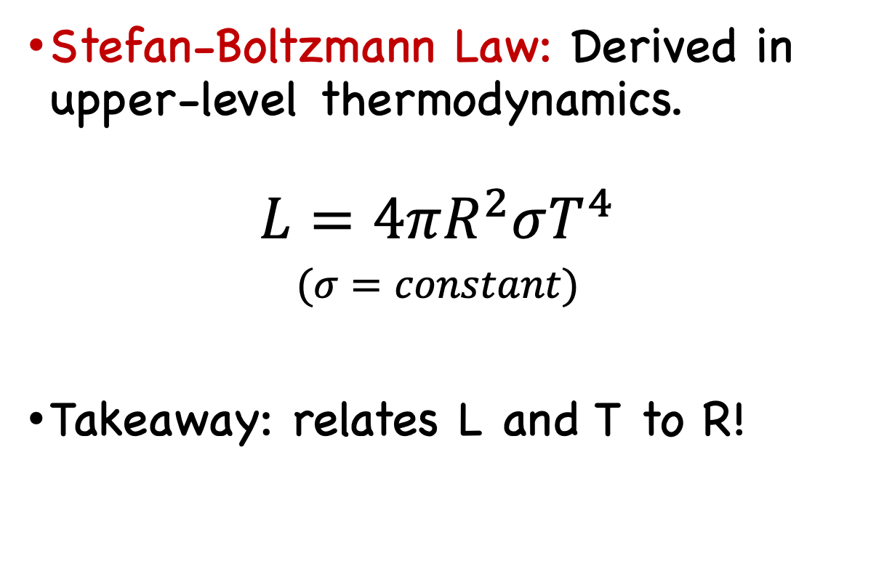
Sizes of stars
Stefan-Boltzmann Law: Derived in upper-level thermodynamics.
$$L=4πR^{2}σT^{4}$$
$$(σ=constant)$$
Takeaway: relates L and T to R!
Notes:
No calculations but appreciate that we can again measure L and T and use that to get R without having to go to the star!

Slide 26
Binary Stars gives Mass
Over 50% of the “stars” you see are actually multiple systems bound by gravity. Most are double. Many triple and higher.
Yet another application of Kepler’s and Newton’s laws.
Equal masses
m₁ >> m₂ (Like star and planet)
x
x
x
CM
m₁
r₁
r₂
m₂
Notes:
Binary stars give us useful predictions on mass, know several 100 masses very accurately now. Great application of physics you already learned.

Slide 27
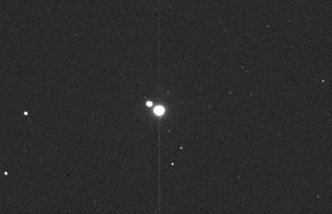
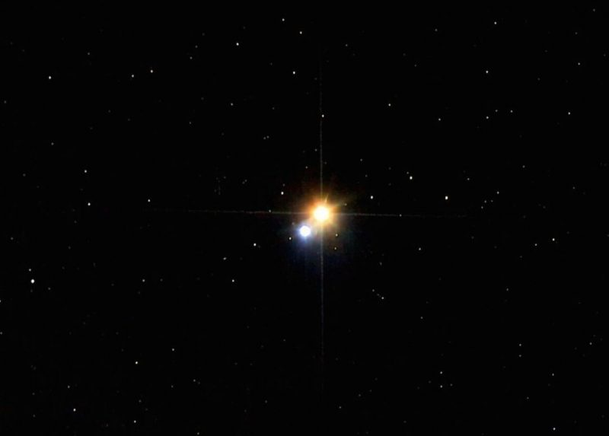

Slide 28
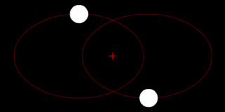
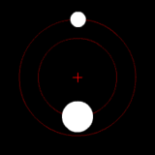
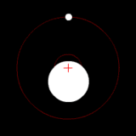
Like a star and a planet →

Slide 29
Binary Stars gives Mass
Over 50% of the “stars” you see are actually multiple systems bound by gravity. Most are double. Many triple and higher.
Yet another application of Kepler’s and Newton’s laws.
Equal masses
m₁ >> m₂ (Like star and planet)
x
x
x
CM
m₁
r₁
r₂
m₂

Slide 30
Notes:
Can now look at all these quantities and see how they scale with mass of the star.

Slide 31
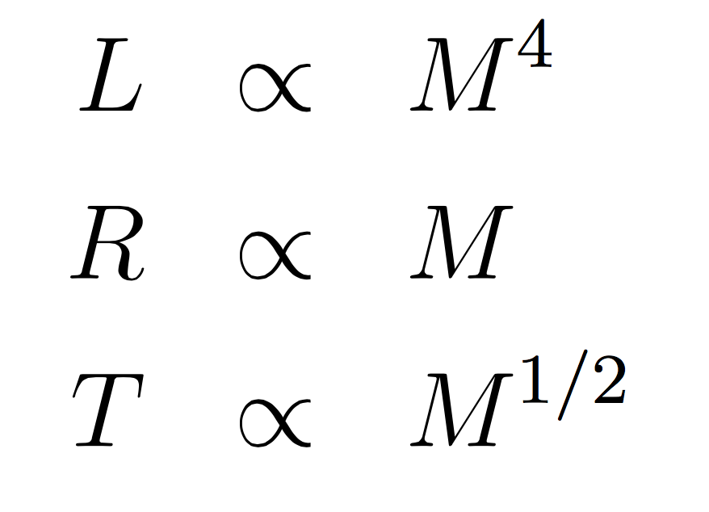
Trends for Main-Sequence Stars
Once all stellar properties were measured, trends emerged. Eventually derived.
All stellar properties can be scaled to mass (“scaling relations”)
These relations are true only for main-sequence stars (nuclear physics built into these expressions)
The mass-luminosity relation implies that massive stars live short lives. They have more fuel, but burn through it faster!
Notes:
What was found? Trends amongst all the variables for the nearby stars that we could measure accurately. Eventually we derived these once we understood the physics. Everything can be scaled to mass.
Bigger stars live shorter lives, kinda counter intuitive. Star 10 times the mass of the Sun has 10 times as much fuel, but burn through it at a rate that is 10^4 = 10,000 times faster! Party hard, die young.

Slide 32
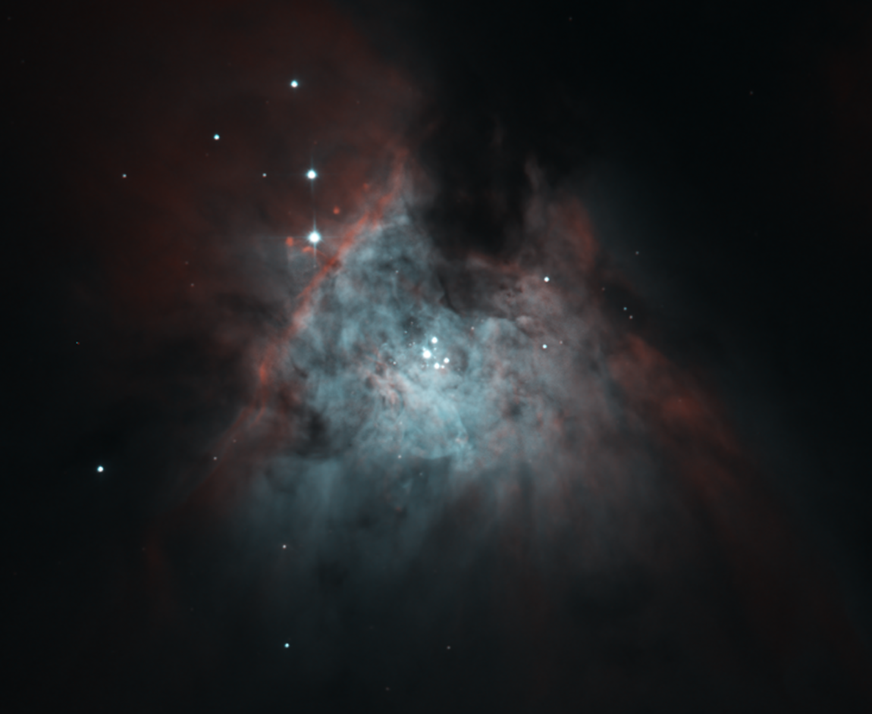
Notes:
Trapezium OB Stars has to be very young stars, formed in the past few million years. Live for 10 million years at most.

Slide 33
Some Properties of MS Stars
Type | Mass (Sun) | T (K) | Luminosity (Sun) | R (Sun)
05 | 40 | 40,000 | 500,000 | 18
B0 | 18 | 28,000 | 20,000 | 7.4
B5 | 6.5 | 15,000 | 800 | 3.8
A0 | 3.2 | 10,000 | 80 | 2.5
F0 | 1.7 | 7,400 | 6 | 1.4
G0 | 1.1 | 6,000 | 1.3 | 1.1
K0 | 0.8 | 4,900 | 0.4 | 0.8
M0 | 0.5 | 3,500 | 0.03 | 0.6
M5 | 0.2 | 2,800 | 0.008 | 0.3
The Sun is a G2 star. Majority of stars in galaxy are K and M (average mass = ½ the Sun). Still, the Sun is a garden-variety star.
Notes:
Numerically seeing the trends shown on the previous slide.

Slide 34
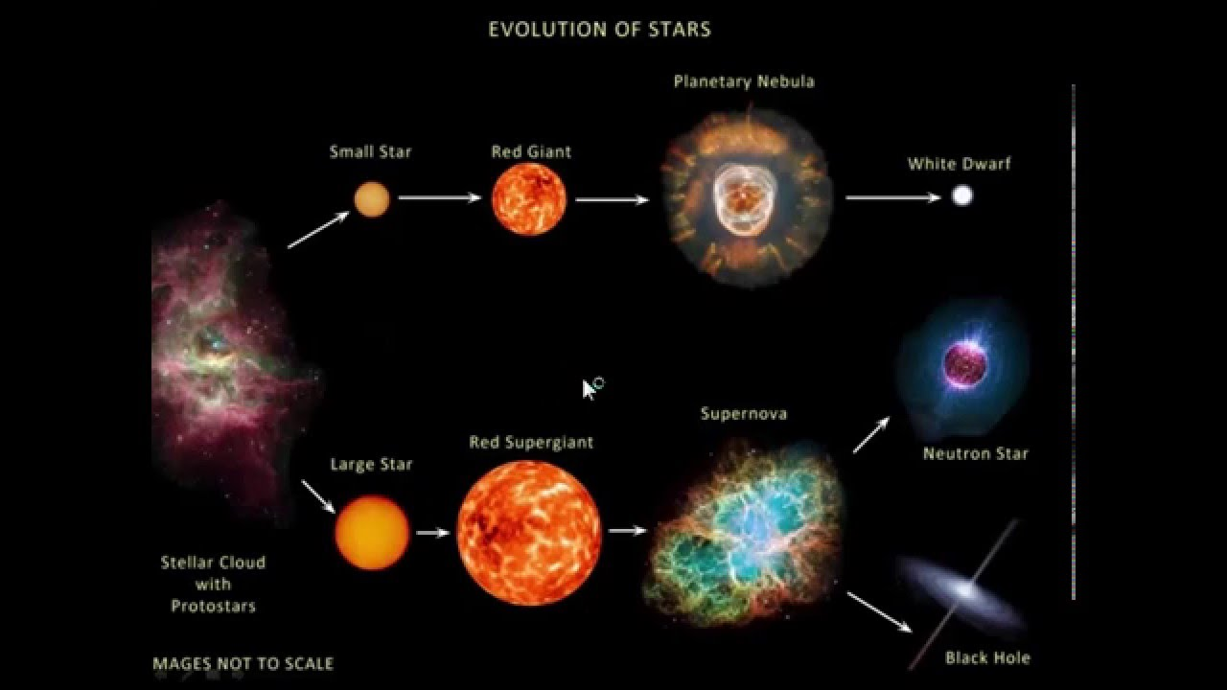
Notes:
~ 20 minutes left..?
Now we know how to measure stars. We can put this together to understand relationships and evolution. Focusing now on just the first image here. Hard to do with single stars. Biggest stars last 10 million years, >>> human life, almost nothing
Instead you look at many stars at many different stages, like if you studied humans you wouldn’t study one

Slide 35
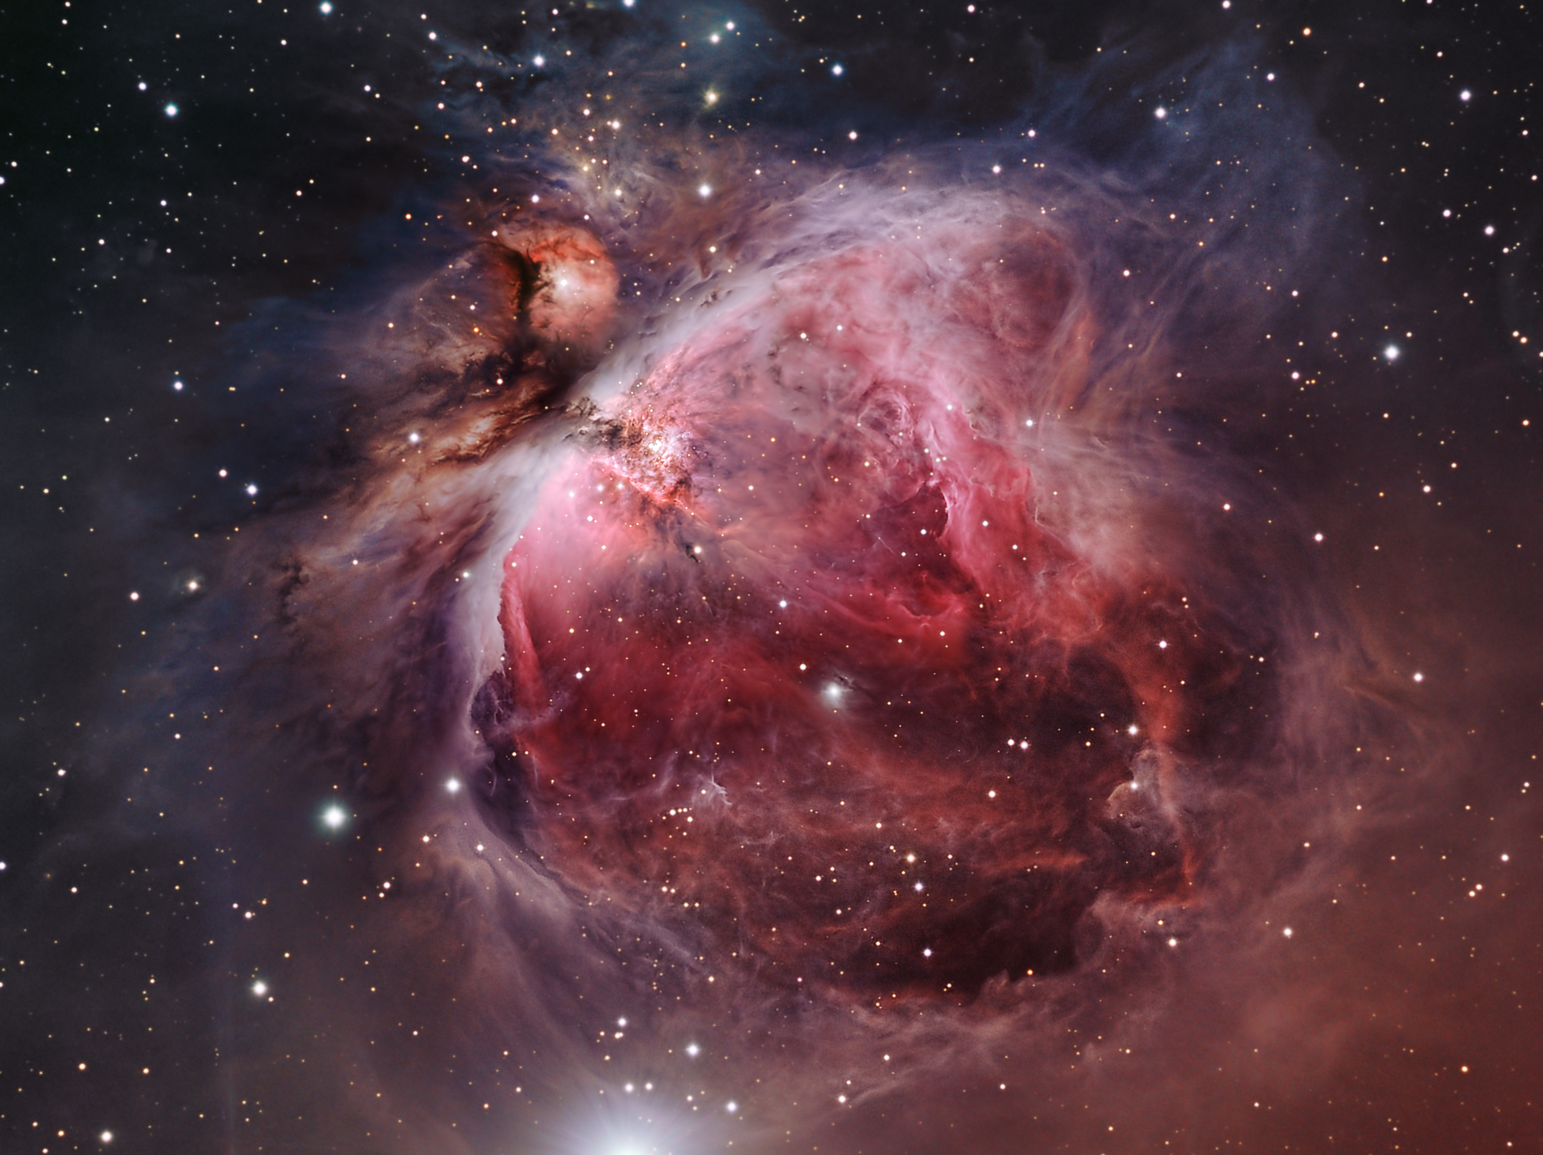
~15 light years
Notes:
Stellar evo same way, you study a bunch at different stages of their development. What have we learned?
Starts as a large cloud of gas and dust (small particulate matter). Orion nebula, a collection of a couple thousands suns worth of gas and dust. Know they form there cause OB stars present.

Slide 36
Gravity
Gravity
Gravity
Gravity
Notes:
Gravity starts to do its thing. Gravity always wants to pull everything together. Breaks into pieces, or fragments.
Collisions heat things up

Slide 37
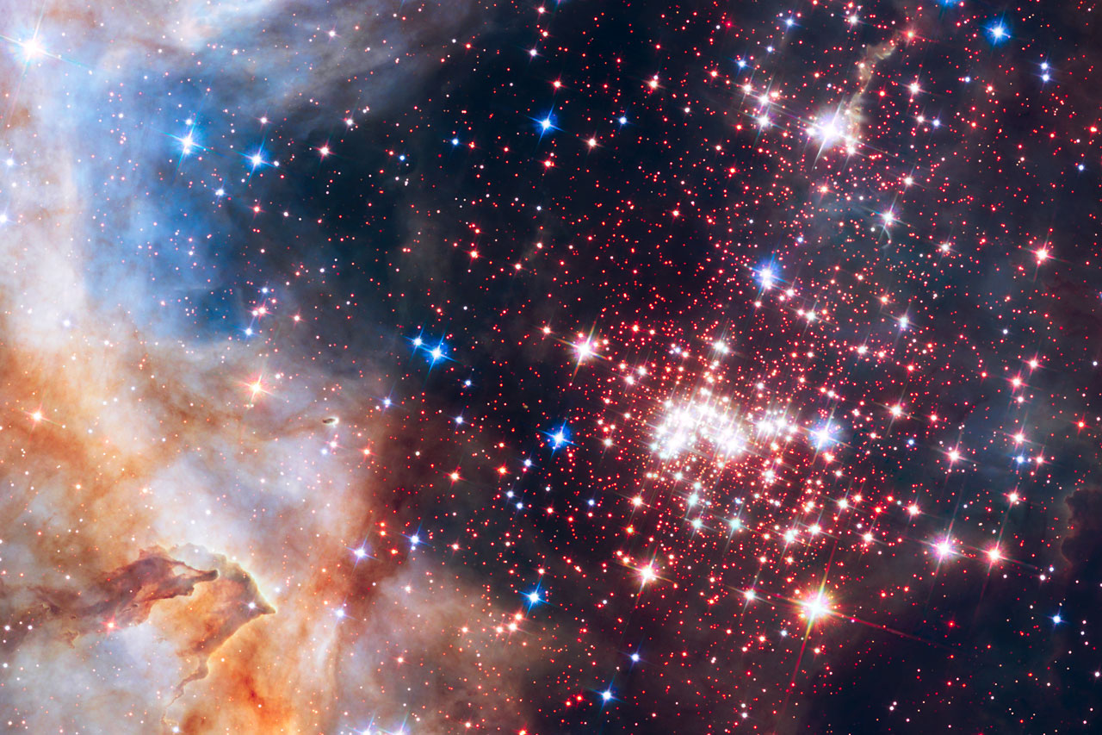
Notes:
And eventually stars form. Regions get hot enough because of all that infall resulting in gas colliding with itself. Eventually gets hot to become individual thermal objects.

Slide 38
Stars and Star Formation
Gravity’s constant battle against pressure.
Gravity wants to brings everything together.
(Thermal) Pressure wants to spread everything out.
Start with a giant cloud of gas. If massive enough, own self gravity can cause collapse.
Cloud fragments into multiple stars all forming simultaneously.
As regions condense, collisions raise temperature up. Eventually hot enough to be stars.
Notes:
Here’s a summary of what I just said. Now Let’s look at that in a little more detail.

Slide 39
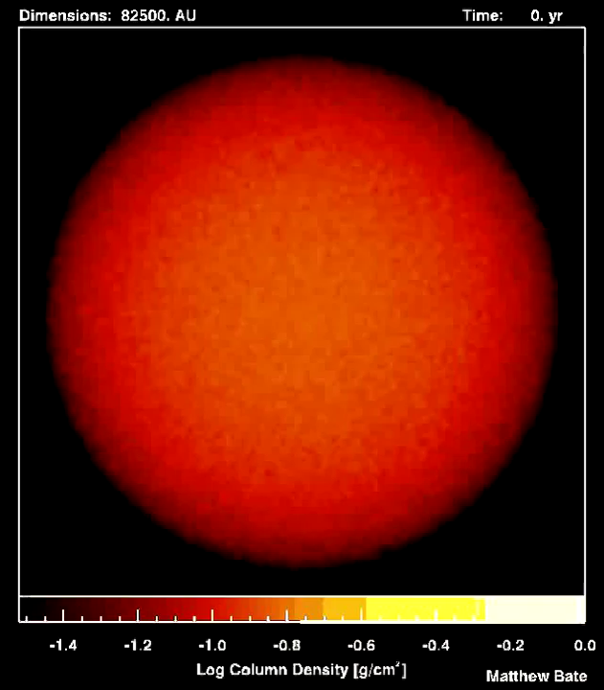
Notes:
This is a process that takes 100,000 to millions of years. You can simulate this entire process on a computer too.
Protostars – regions in collapse, building up in temperature. Eventually stars

Slide 40
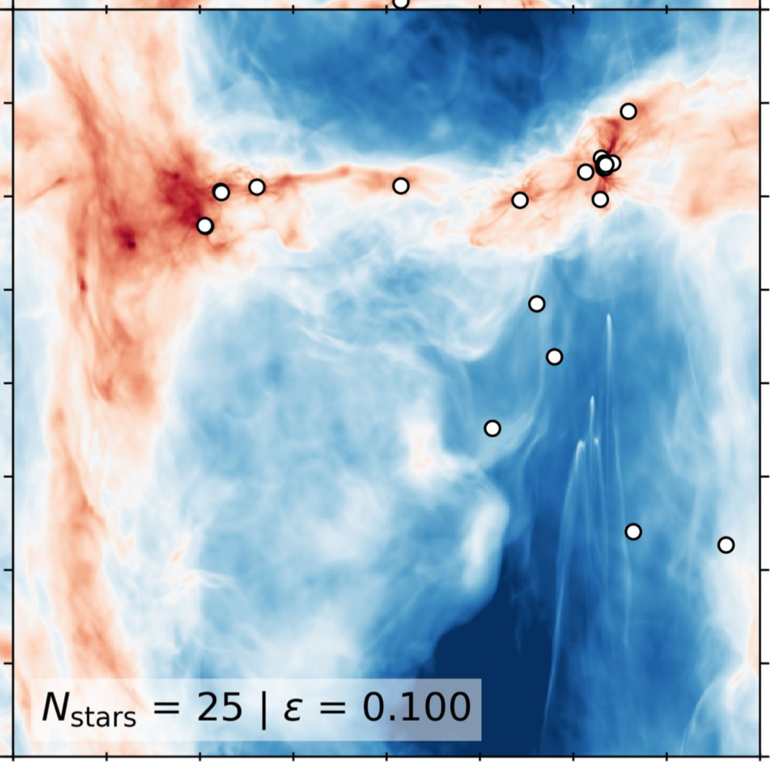
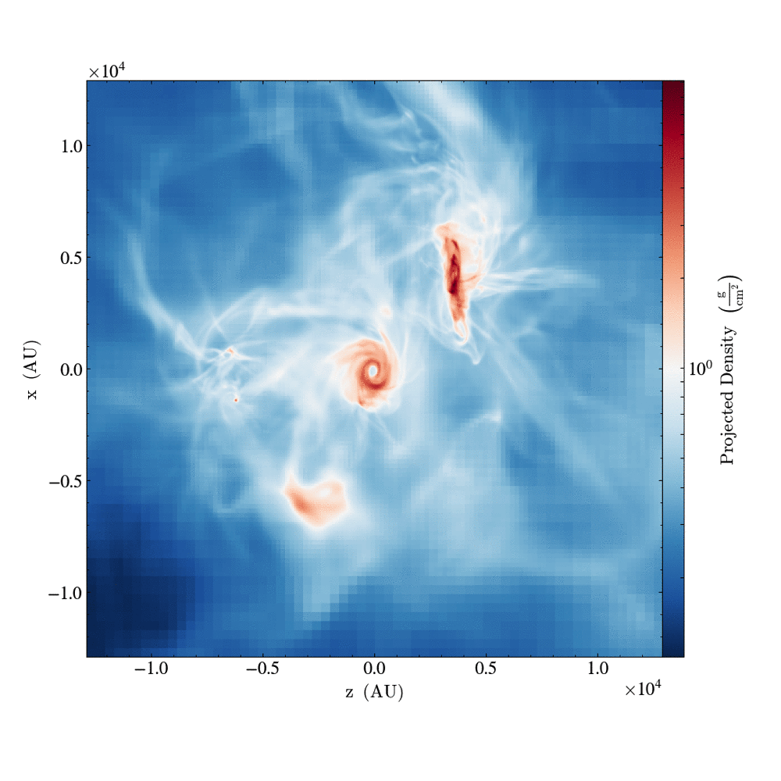
← 2 parsecs in length →
Notes:
Example from my own work.

Slide 41
Heading Toward Stars
As cloud contracts, fragments into pieces (“protostars”). Their own gravity takes over and forces them into free-fall collapse.
As the density of the protostar grows, so does the temperature and pressure, especially in the center.
Locations of protostars
Gravity
Pressure
Notes:
As gravity contracts, fragments into pieces. These small parts of the cloud get denser and denser and form protostars. Pressure is beginning to build up. Bulk KE is turning into random thermal energy that exerts pressure.

Slide 42
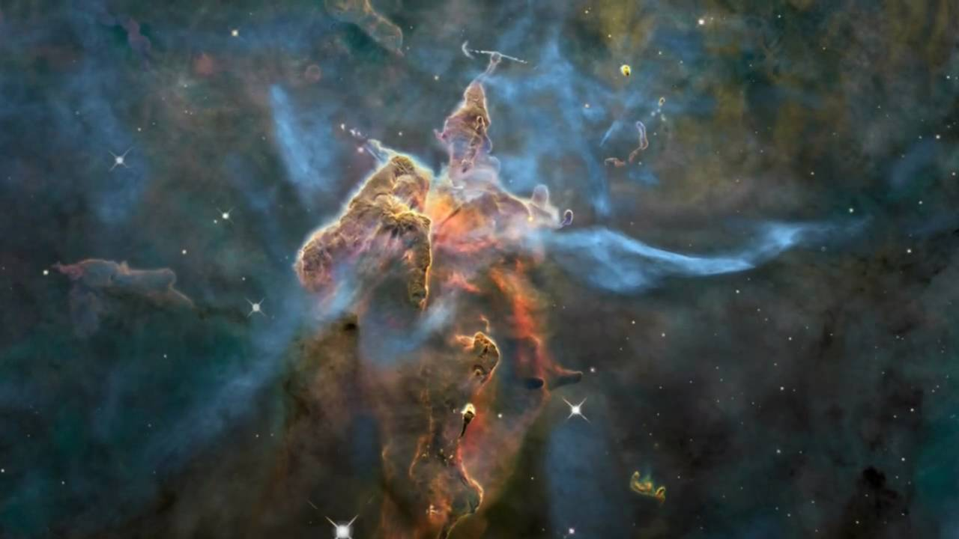
Notes:
Carina nebula, good example.

Slide 43
Notes:
Zooming in, we see clumps.

Slide 44

A Star is Born
radiation
Gravity
Slow Contraction
pressure
Fusion in core
Nuclear energy in center provides pressure and energy when T > 10⁷ K
Hydrostatic Equilibrium: Stable balance between pressure from nuclear fusion and gravity.
Gravitational contraction releases energy, no fusion yet.
Notes:
Lots of energy is being released during this time. Protostars are very bright.
Fusion starts pushing back, keeping the gas hot enough so that the pressure is high enough to prevent gravity from contracting the object.

Slide 45
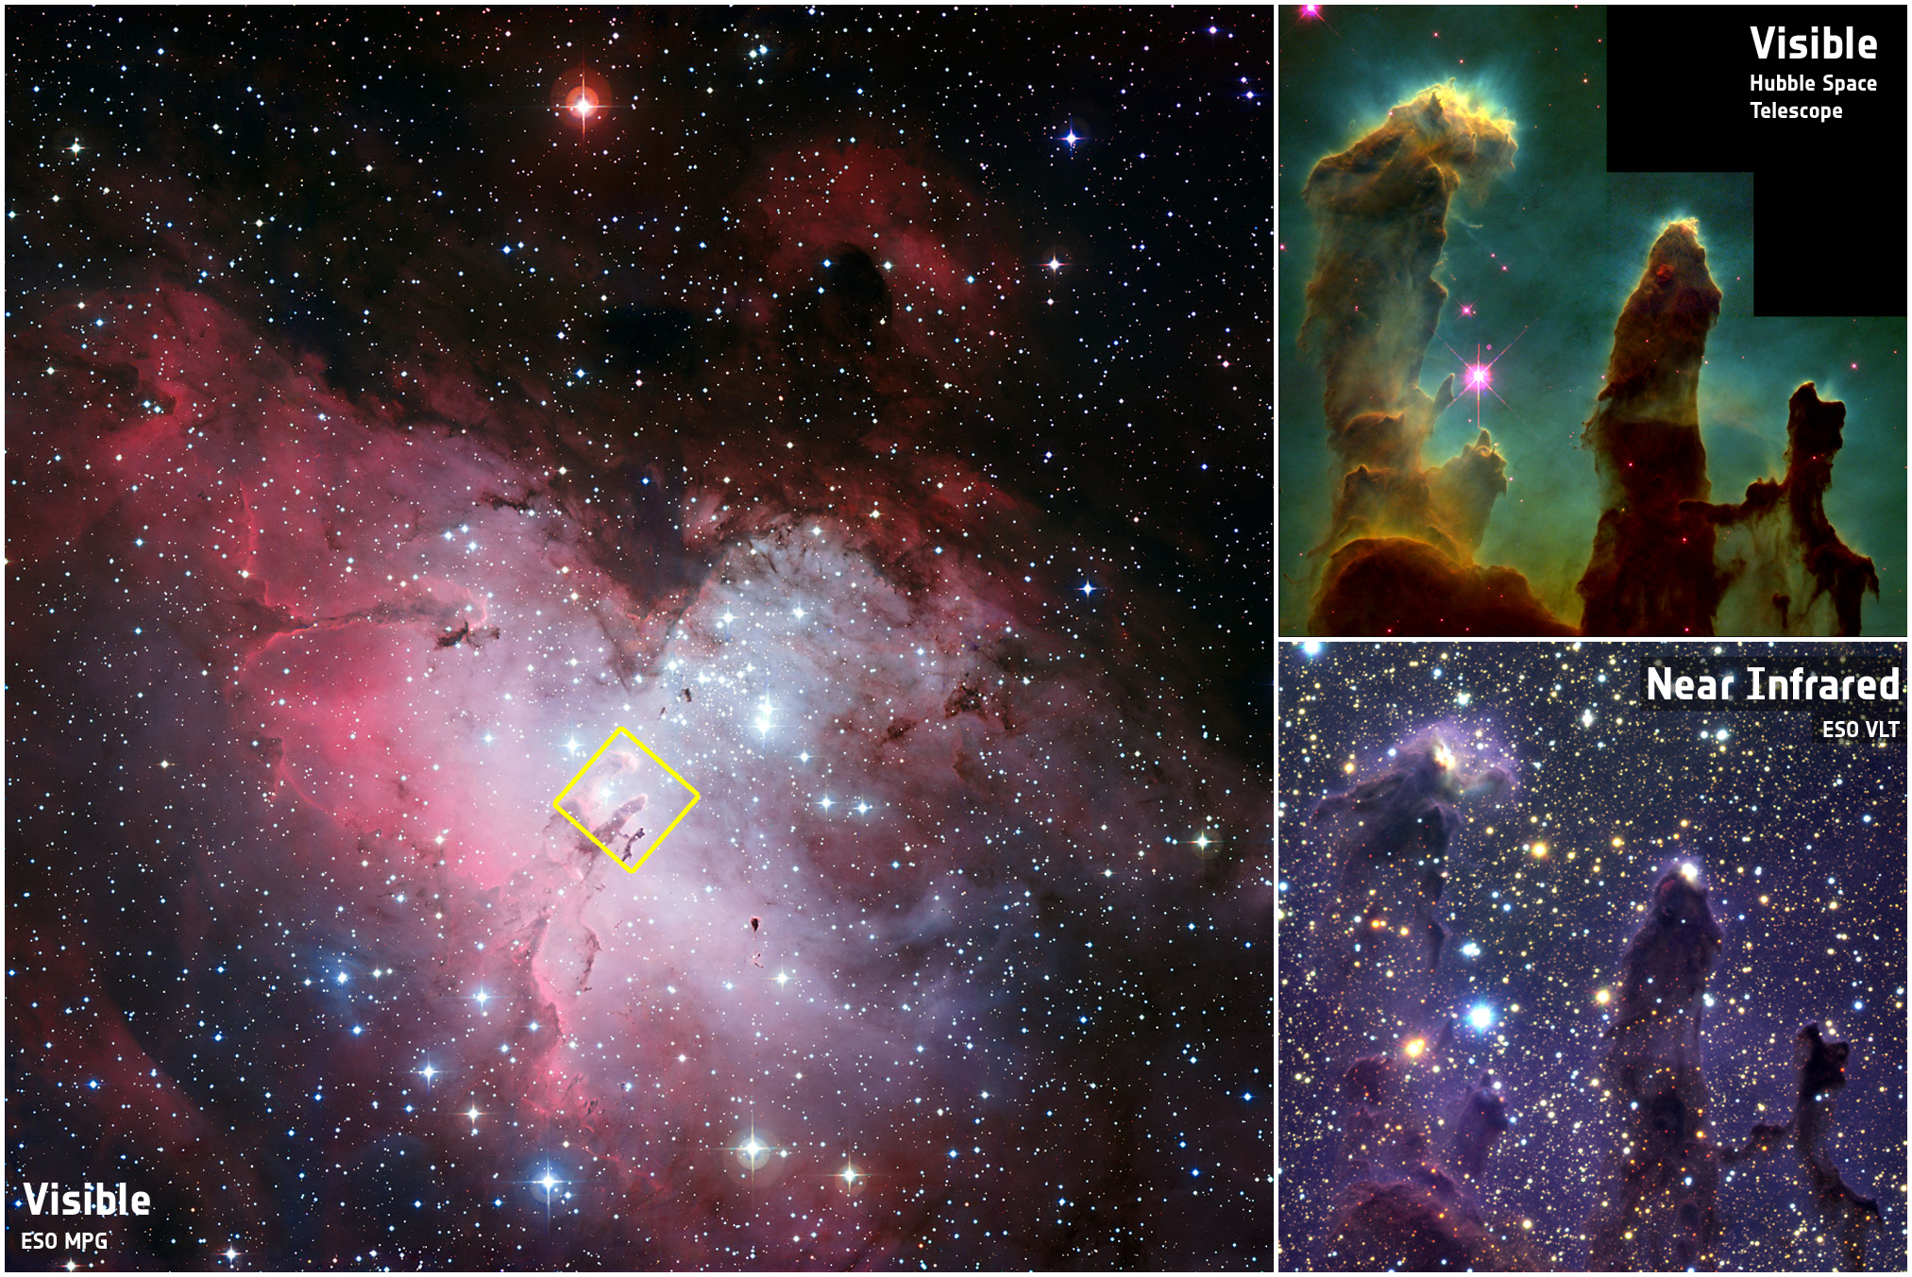
Notes:
We see this happening.
Pillars of creation, opaque in visible.
Transparent in IR
Stars blowing up region

Slide 46
A Star is Born
When the temperatures get sufficiently high in the center (> 10⁷ K), quantum nuclear reactions start to take place:
A STAR IS BORN!
Star settles onto the main sequence; contraction ceases. L and T stabilize.
Nuclear reactions provide a counterbalance against gravity’s never-ending pull.
Star is in “hydrostatic equilibrium”
Notes:
For the rest of the objects, the contraction keeps going. Eventually the core gets hot , 10-15 million degrees.
Nuclear reactions start happening.

